Slide 1



Solar magnetic fields:
diagnostics and applications
^{A. Asensio Ramos}
Instituto de Astrofísica de Canarias
aasensio.github.io/blog
@aasensior
github.com/aasensio

Slide 2
Solar magnetic fields:
diagnostics and applications
Day 3
Non-linear inversion
Posing the problem – Bayesian inference
ML simple solution through response functions
Levenberg-Marquardt
Milne-Eddington solution
Principal component analysis

Slide 3

The Milne-Eddington approximation
Atmosphere is plane-parallel, semi-infinite and in local thermodynamic equilibrium
Line opacity, Doppler width, line properties and magnetic field vector is constant with depth in the atmosphere
The Planck function is linear with optical depth

Slide 4
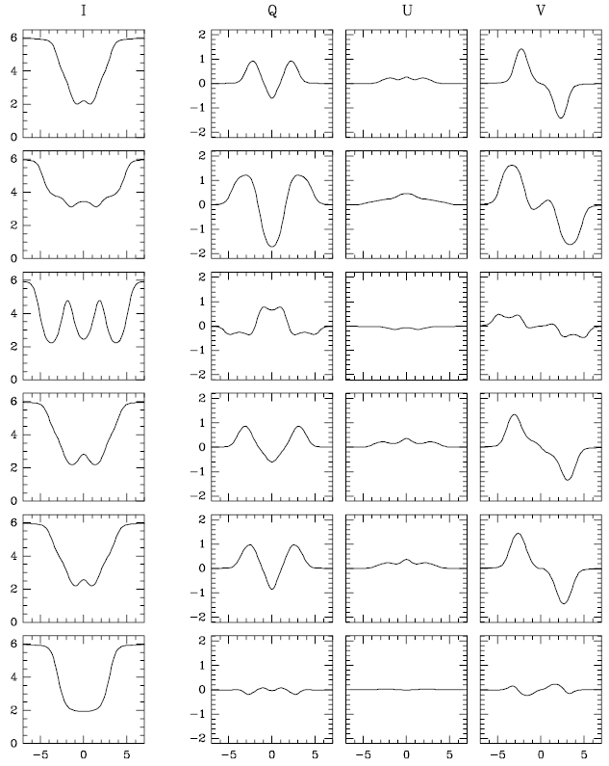
The Milne-Eddington approximation is broadly used
¹S₀-¹P₁
⁵D₂-⁷D₃
⁵P₁⁻⁵F₁
⁵D₃-⁵F₃
⁵P₃⁻⁵D₄
⁵D₁-⁵G₂

Slide 5
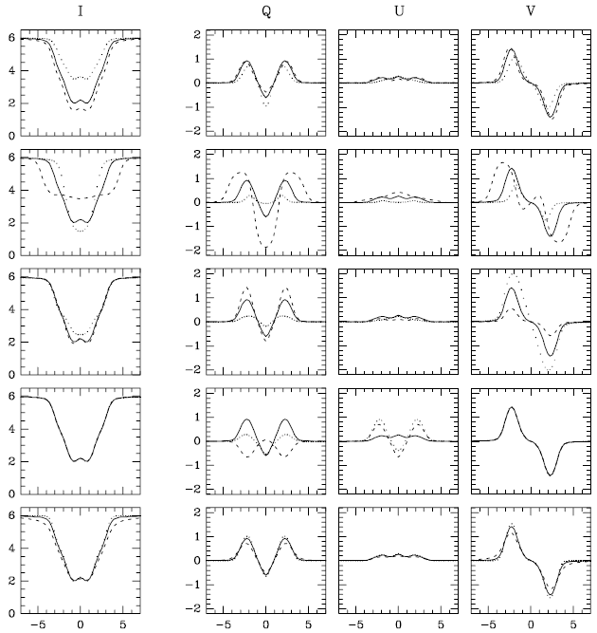
The Milne-Eddington approximation

Slide 6
Zeeman Saturation is correctly captured

Slide 7
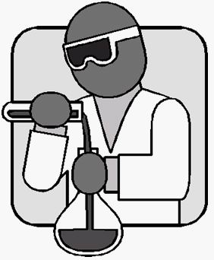
http://goo.gl/dj2ob

Slide 8
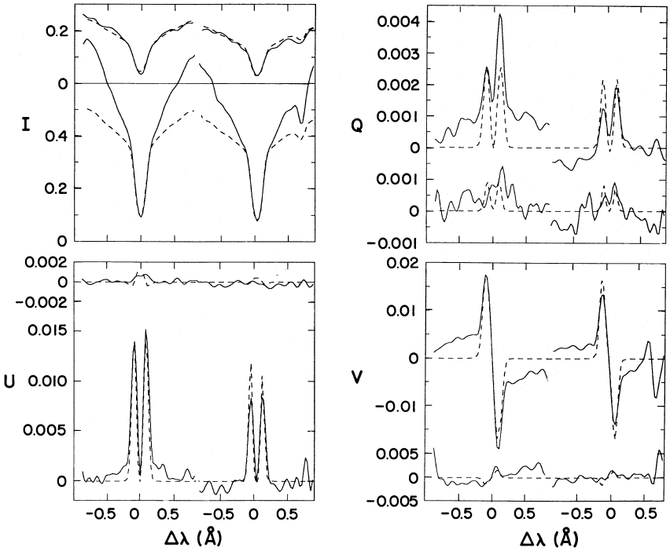
Milne-Eddington with Zeeman effect
Lites et al. (1988)

Slide 9
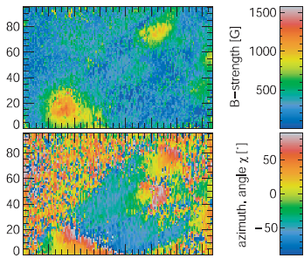
Milne-Eddington with Zeeman effect
Helix →Lagg et al. (2004, 2007)
PB →Socas-Navarro et al. (2005)

Slide 10

How to do the fitting?
The (parameterized) atmosphere is modified iteratively until a good
fit is obtained in the Stokes parameters
Using the standard least-squares solution, we want to minimize the
merit function that measures the distance between the
observed Stokes parameters and the synthetic ones
Synthesis
Observations
Noise

Slide 11



The Levenberg-Marquardt algorithm in a non-linear case
The Stokes parameters at a
new value of the parameters is
where

Slide 12

Linearizing the algorithm
We assume that the χ² at the new position is close to the
minimum. We find this position by setting the derivative equal to
zero and solving for δ
Solve for δ in the linear system →
Levenberg introduced a damping that shifts from a purely
Gauss-Newton method (λ<<1) to a conjugate
gradient method (λ>>1)

Slide 13
Inversion procedure
B, η, v_{th}, v_{mac}, a
Emergent profiles
Observed
Stokes profiles
Statistical estimator (χ²)
NO
χ² smaller than
previous?
NO
Convergence?
Propose another
set of parameters
YES
YES
Save parameters
EXIT

Slide 14
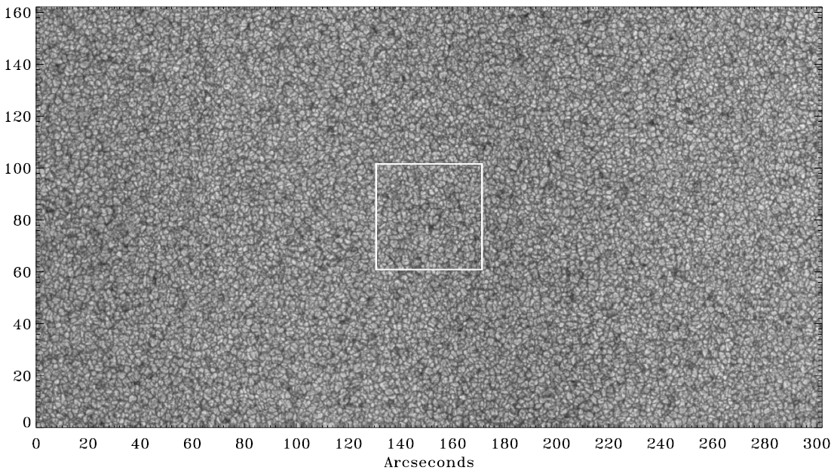
Observations from space - Hinode
Lites et al. (2008)

Slide 15
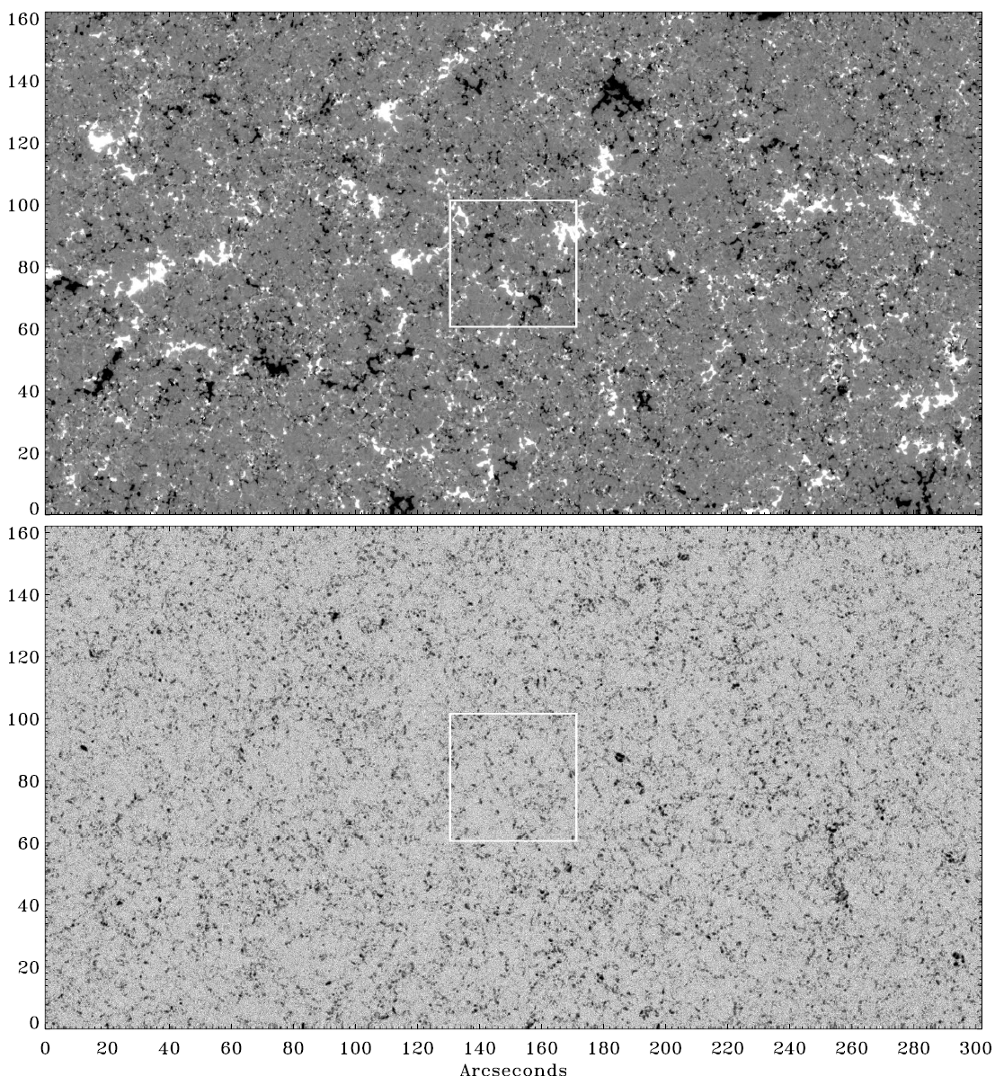
Circular
polarization
Linear
polarization

Slide 16
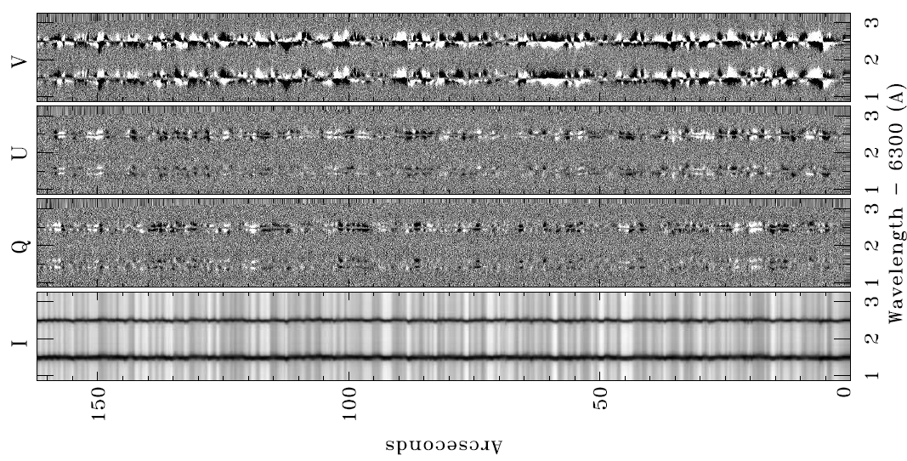
There is signal everywhere

Slide 17
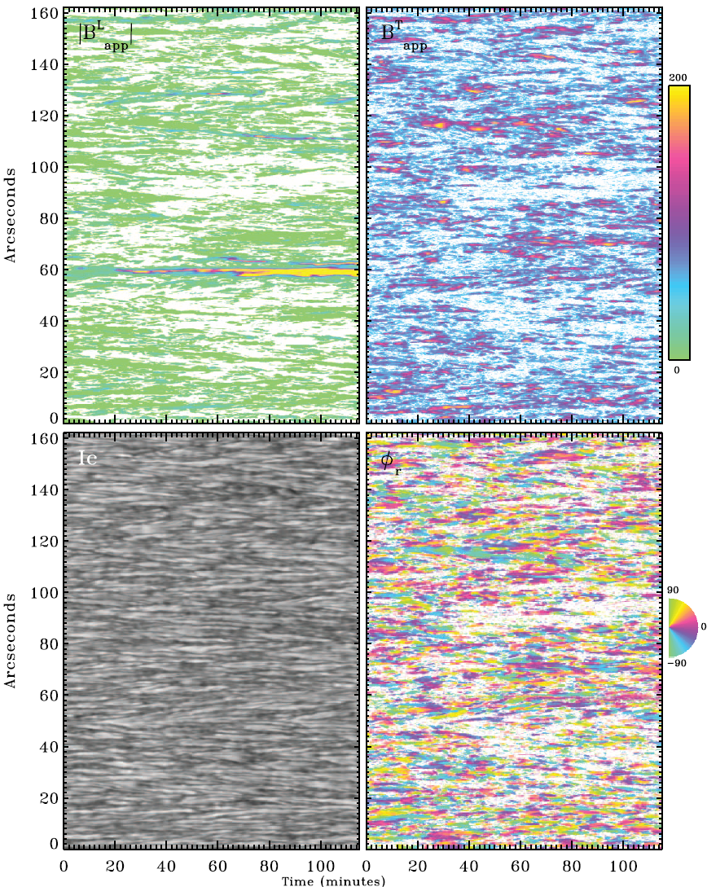
Milne-Eddington inversions give magnetic field properties

Slide 18
Milne-Eddington with Zeeman effect
PROS
Inversion can be made fast
Thermodynamics & magnetic conditions uncoupled (at least verified in photospheric lines)
Some codes are freely available to the community
CONS
Model might be not realistic, specially for pure chromospheric lines or in discontinuous situations (more complex models?)
Errors are sometimes not realistic if ambiguities/degeneracies are present

Slide 19
Gradients along the line-of-sight
Local and non-local thermodynamic equilibrium

Slide 20
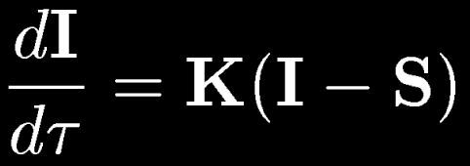
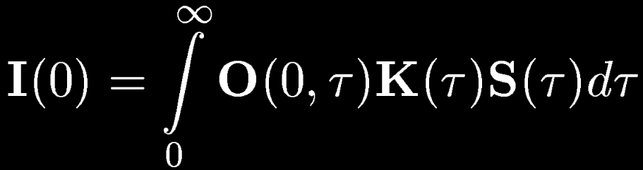
Variation along the line-of-sight (LTE)
When the physical quantities (T, B, etc.) change with height we have
to solve the RT equation to obtain the emergent Stokes parameters
In LTE, the source function is known and depends on local properties
The linear differential equation has the following formal solution
Landi degl’Innocenti & Landolfi (2004)

Slide 21
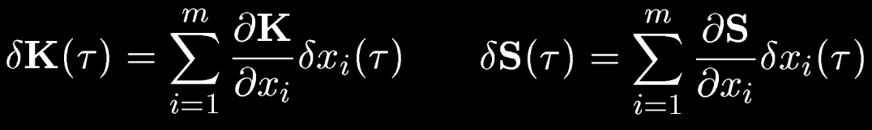
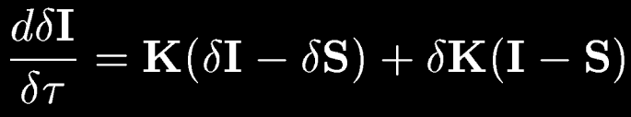
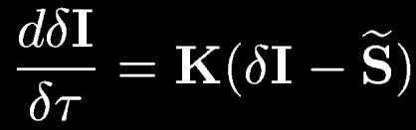
Inversion is more complicated
To do an inversion (Stokes → physical properties), we need to understand
how the Stokes parameters change when a physical quantity is perturbed
At first order:
Which is formally
equivalent to the RT
equation

Slide 22
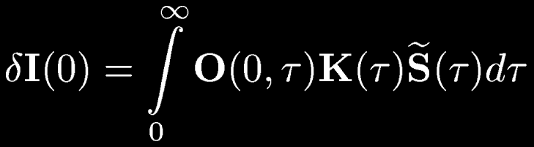

Response functions are the key
The perturbation on the Stokes parameter is given by
Which allows us to define the response function in the integral form
In local thermodynamical equilibrium, it can be computed as

Slide 23
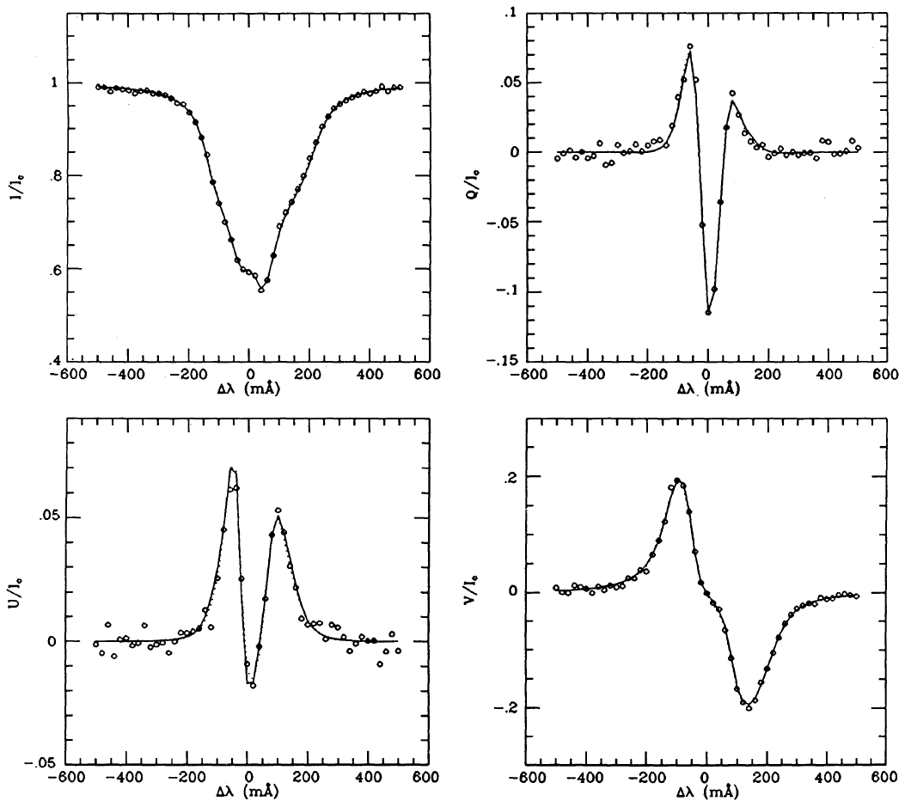
Profiles can be nicely fitted
Ruiz Cobo & del Toro Iniesta (1992)

Slide 24
Inversion procedure (LTE)
B, T, v
Emergent profiles
Observed
Stokes profiles
Statistical estimator (χ²)
NO
χ² smaller than
previous?
NO
Convergence?
Propose another
set of parameters
YES
YES
Save parameters
EXIT
Response functions

Slide 25
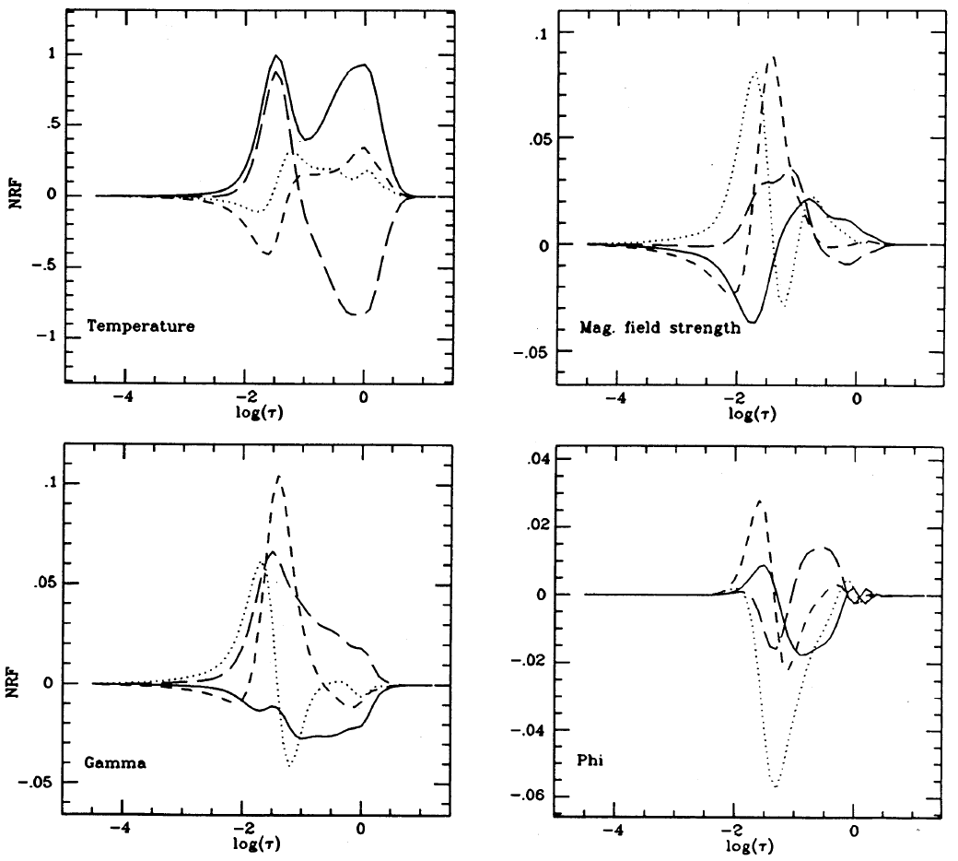
Response functions
Ruiz Cobo & del Toro Iniesta (1992)

Slide 26
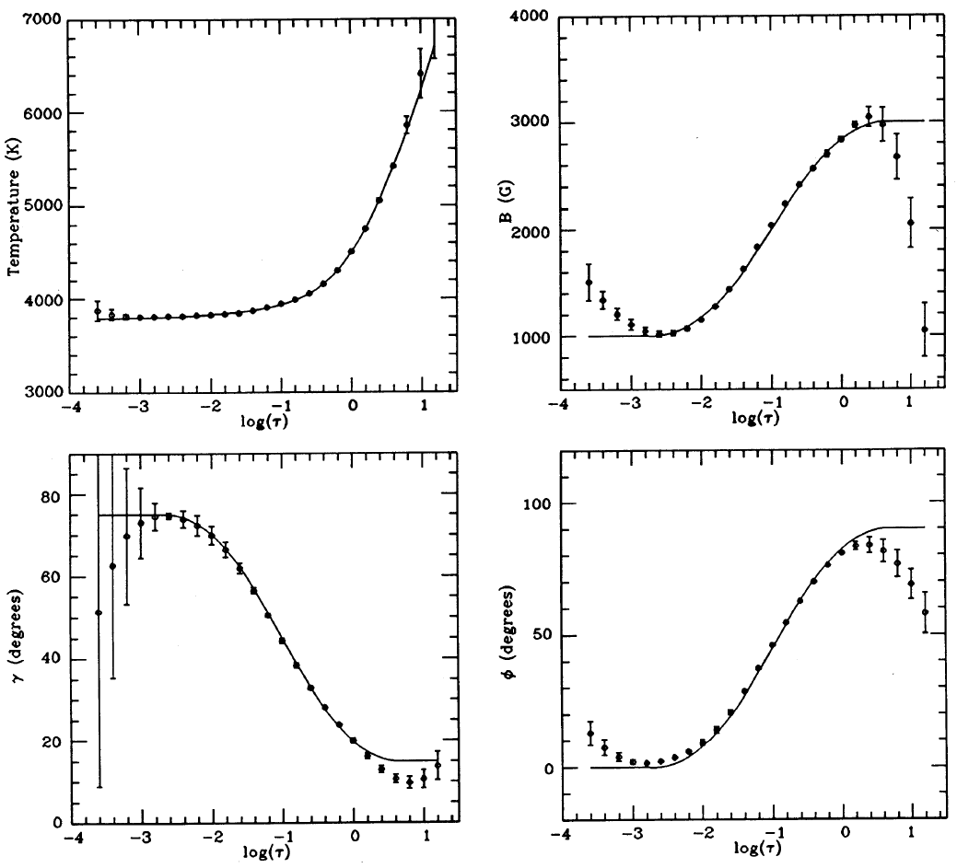
The depth stratification of physical quantities can be obtained
Ruiz Cobo & del Toro Iniesta (1992)

Slide 27
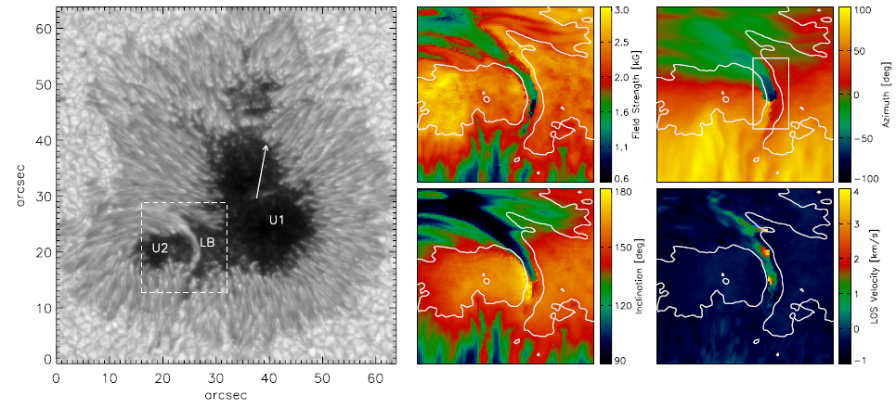
The quality of observations allow to observe fine details
Field strength
Field azimuth
Inclination
LOS velocity
Louis et al. (2009)

Slide 28
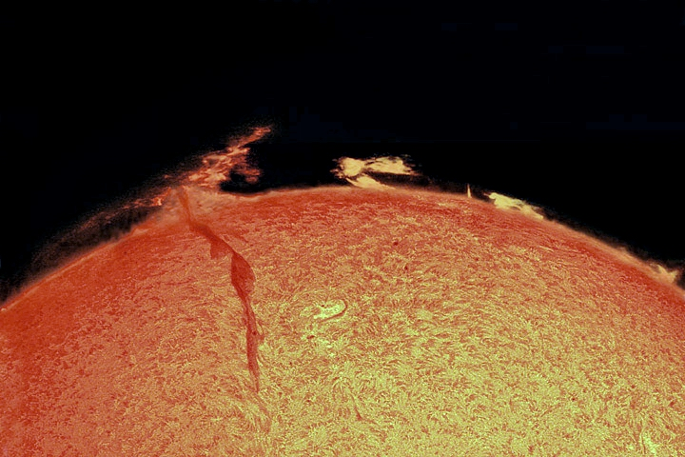
Non-local thermodynamic equilibrium
In NLTE, the source function is unknown and nonlinearly depends
on non-local properties

Slide 29

NLTE: non-local coupling
Radiative transfer equation
Rate equations
Teh Stokes profiles are obtained by self-consistently solving
the two sets of equations → computationally heavy
Rate equations
Radiative transfer

Slide 30
Inversion procedure
B, T, v
Solve SEE
equations
Solve RT equation
Emergent profiles
Observed
Stokes profiles
Statistical estimator (χ²)
NO
χ² smaller than
previous?
NO
Convergence?
Propose another
set of parameters
YES
YES
Save parameters
EXIT

Slide 31
Full NLTE with Zeeman effect
Socas-Navarro et al. 2000

Slide 32
Full NLTE with Zeeman effect
Socas-Navarro et al. 2000

Slide 33
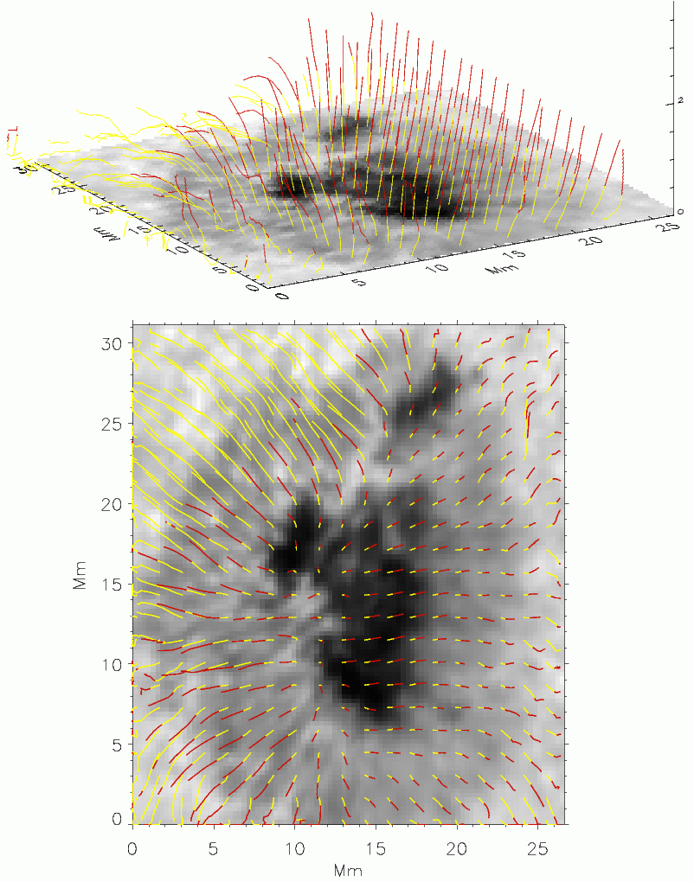
Full NLTE with Zeeman effect
Torsion of field lines with height
Socas-Navarro (2005)

Slide 34
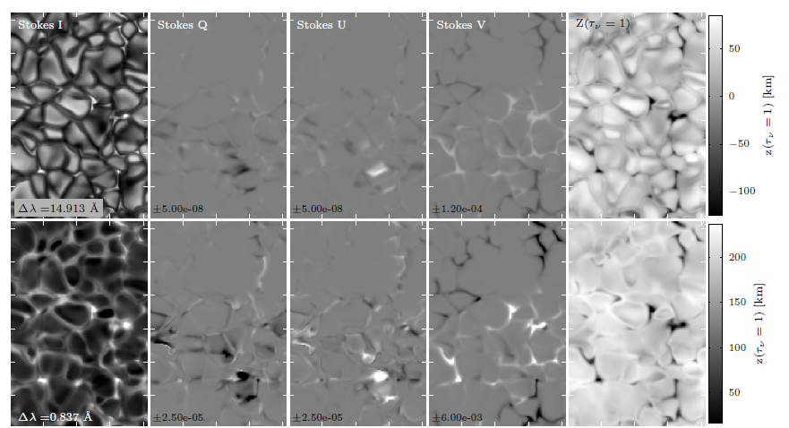
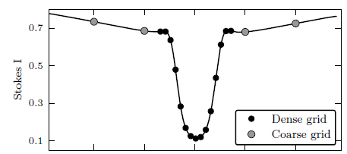
NLTE synthesis with Zeeman effect
de la Cruz Rodríguez et al. (2012)

Slide 35
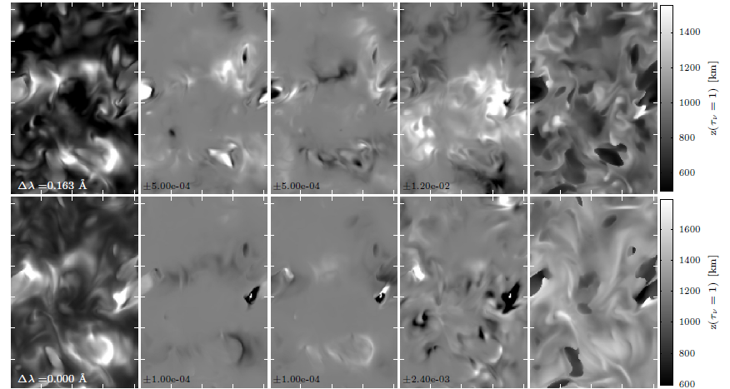
NLTE synthesis with Zeeman effect
de la Cruz Rodríguez et al. (2012)

Slide 36
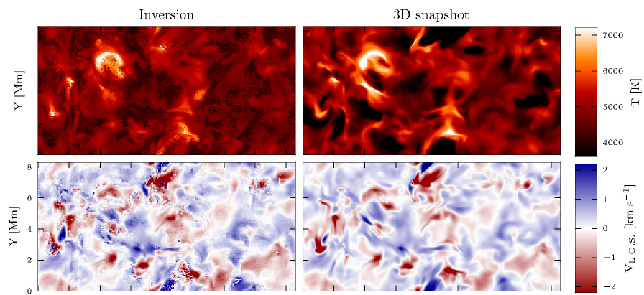
Temperature and velocity can be inferred
de la Cruz Rodríguez et al. (2012)

Slide 37
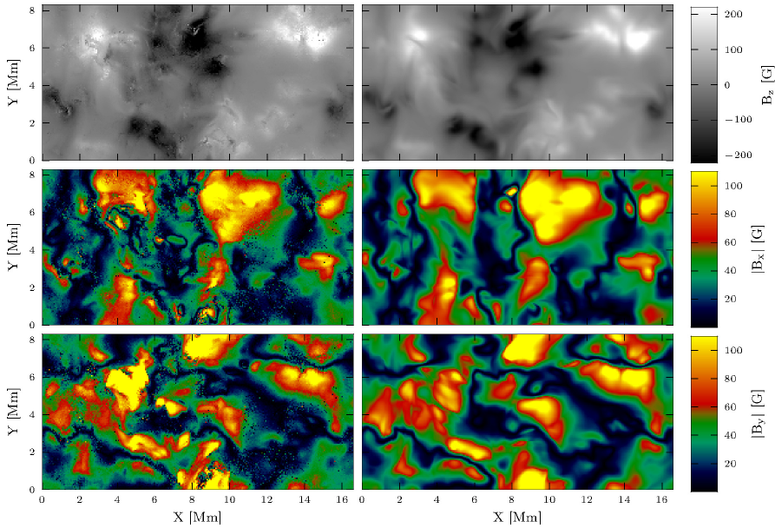
Magnetic field properties can be inferred
de la Cruz Rodríguez et al. (2012)

Slide 38
http://goo.gl/dj2ob

Slide 39
Do we want very complex models? It depends…
The information encoded on the Stokes profiles is limited and
we have to use models of the appropriate complexity
Although the Stokes profiles dimensionality is potentially R^{N} (with N the
number of wavelengths) they live instead in a manifold of much reduced
dimensionality because of the presence of correlations (physics)

Slide 40
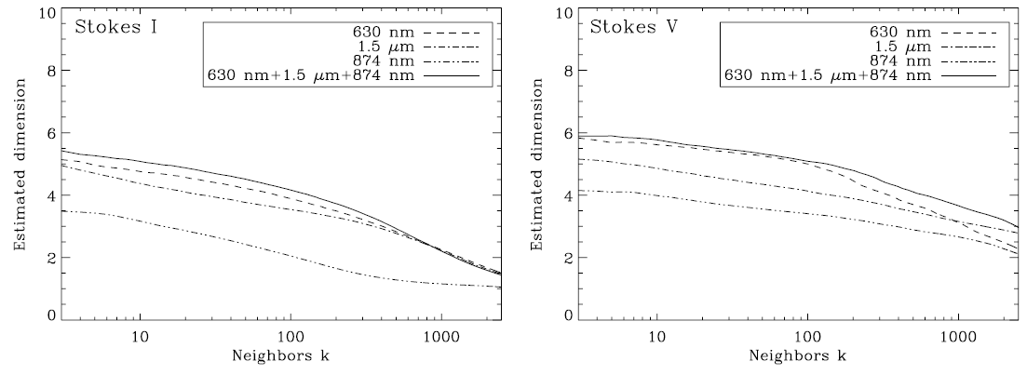
Observations set the maximum complexity
Our model cannot have many more parameters than the intrinsic
dimensionality of the Stokes profiles
Additionally, there are competing models to explain the observations
and we need a quantitative way of choosing among them
Asensio Ramos et al. (2007)

Slide 41
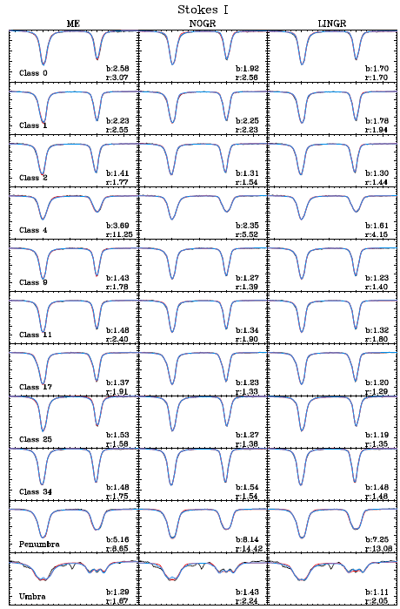
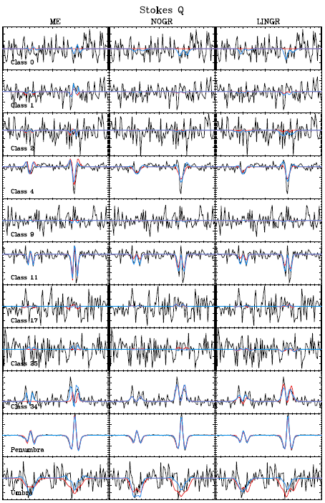

Slide 42
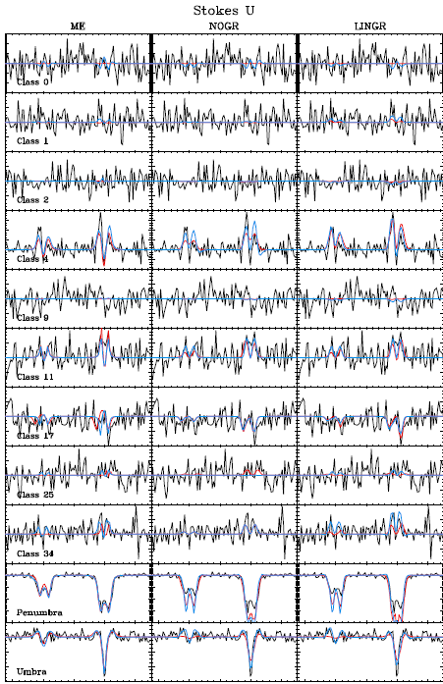
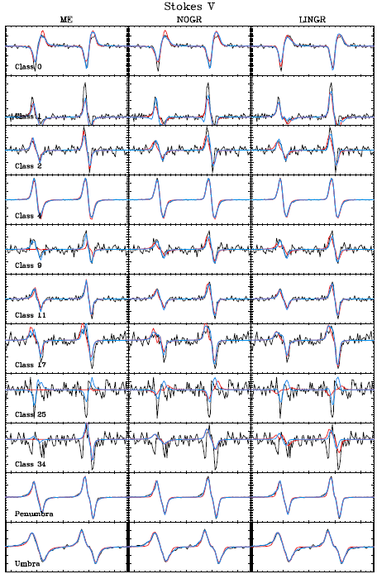

Slide 43
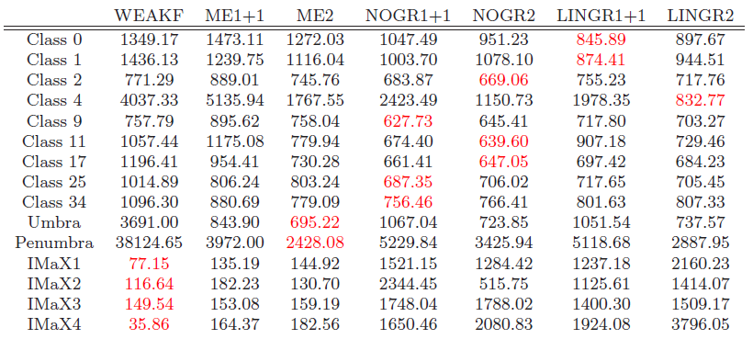
Competing models can be compared using BIC
Select the model giving the smallest BIC
The best model is correctly selected in ~80% of the cases

Slide 44
Stellar magnetic fields

Slide 45
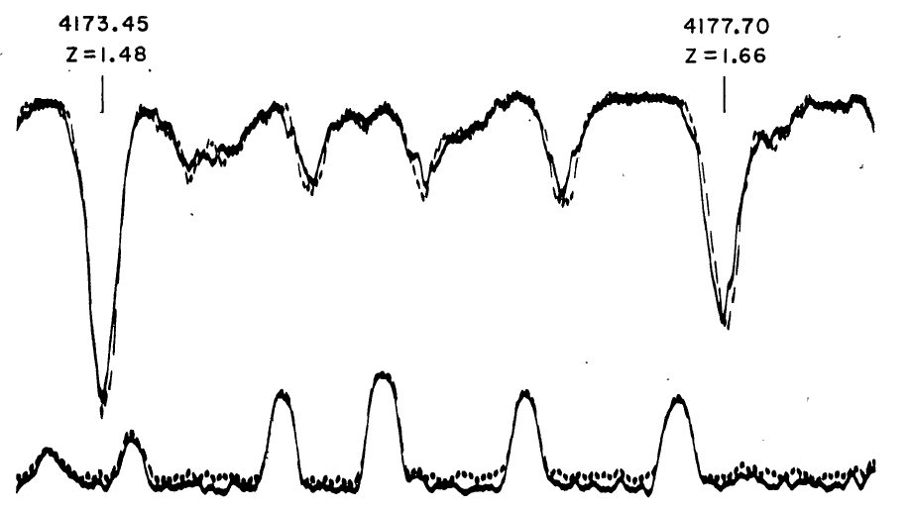
Magnetic fields in stars
Left-hand
Left-hand
Babcock (1947)

Slide 46
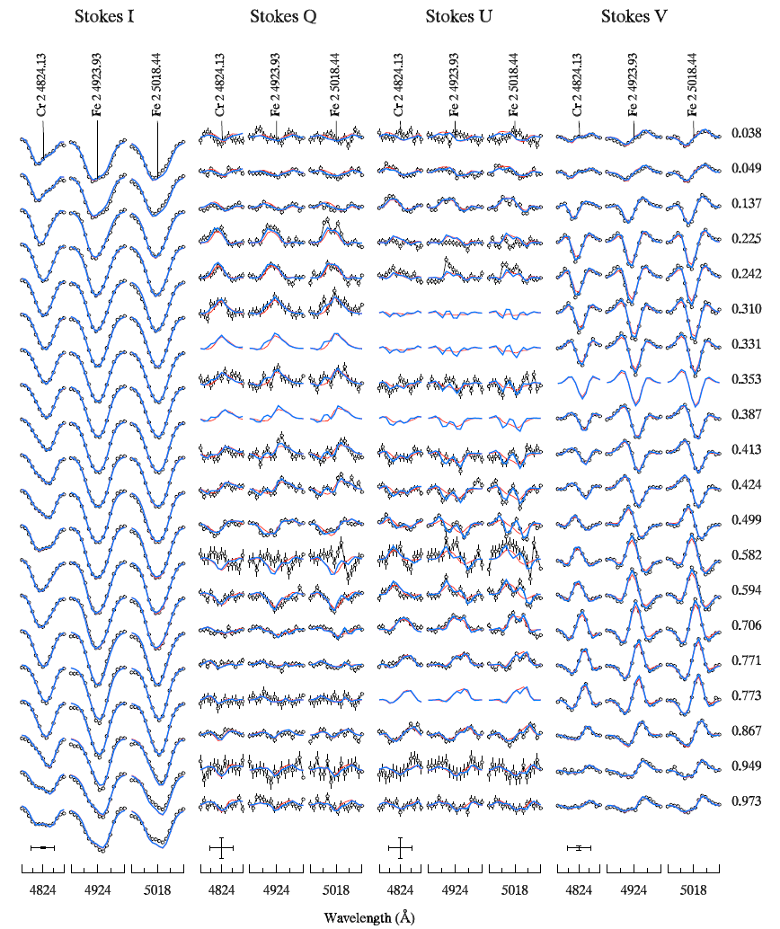
Polarization can be used to estimate m.f. in stars
Kochukov & Wade (2010)

Slide 47
Multiline techniques. Improving signal-to-noise ratio
In solar-type stars, the polarization signal per line is very weak because:
Magnetic configuration is complex and leads to cancellation
Rotational broadening of lines generate weak Zeeman signals
…
Semel (1989), Semel & Li (1996) and, later, Donati et al. (1997) and
Martínez González et al. (2008) developed multiline techniques do
enhance the probability of detection
The essential idea is that:
Noise adds up in an uncorrelated way
Real polarization signal adds up in a correlated way (the S/N typically enhances as N^{1/2}

Slide 48



All techniques are essentially ‘line addition’
Line addition (Semel 1989)
Improved line addition (Semel 1995)
Least squares deconvolution (LSD; Donati et al. 1997)
Semel et al. (2009)

Slide 49
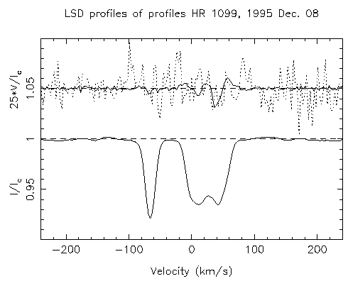
Detecting polarization with line-addition techniques
Donati et al. (1997)

Slide 50
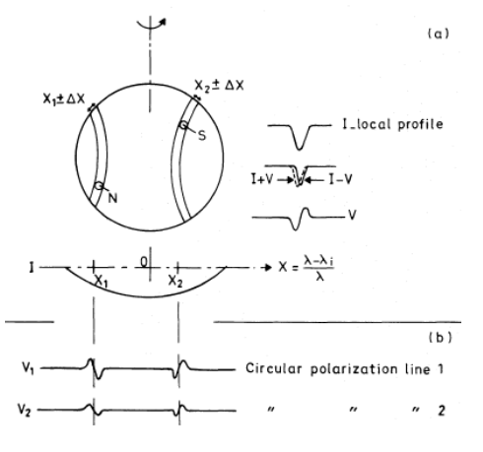
Zeeman Doppler Imaging. Rotation helps see m.f.
Why do we see Zeeman signal in a magnetic star if the field is
homogeneous on the surface?
Semel (1989)

Slide 51
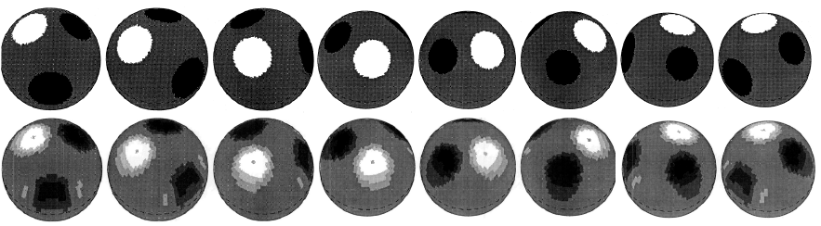
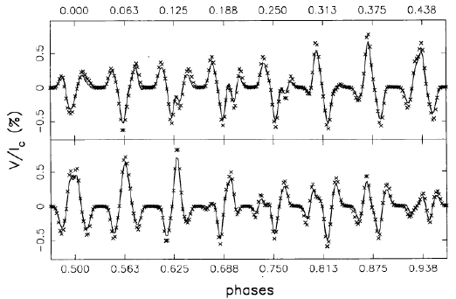
ZDI – Signal changes with phase
Brown et al. (1991)

Slide 52
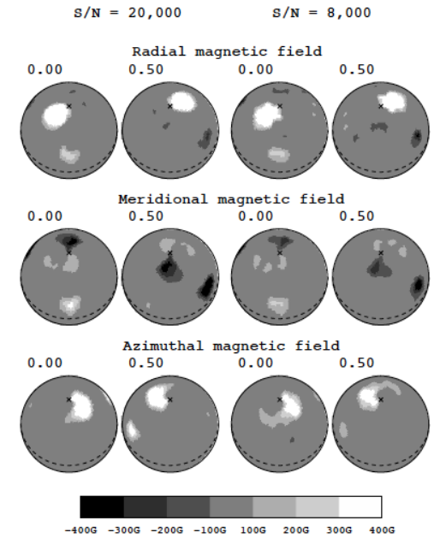
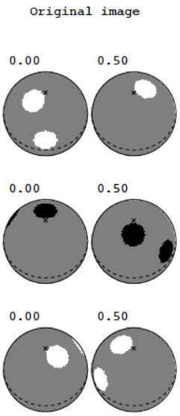
ZDI – It works!
Donati et al. (1997)

Slide 53
Scattering polarization and the Hanle effect

Slide 54
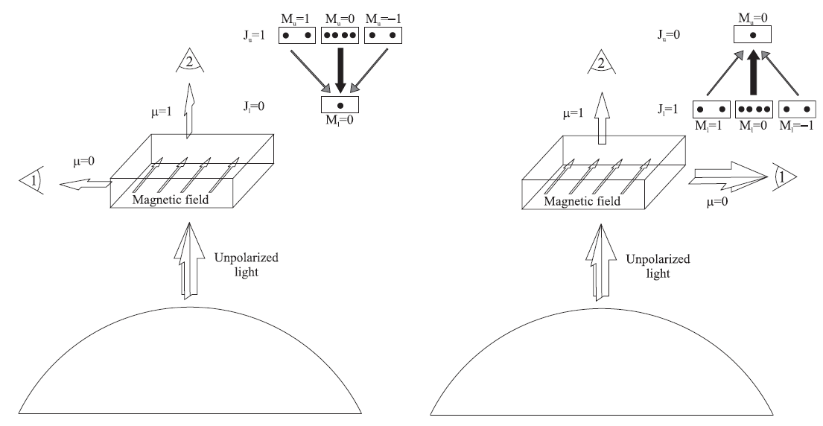
Scattering produces polarization
Scattering polarization + Hanle effect

Slide 55
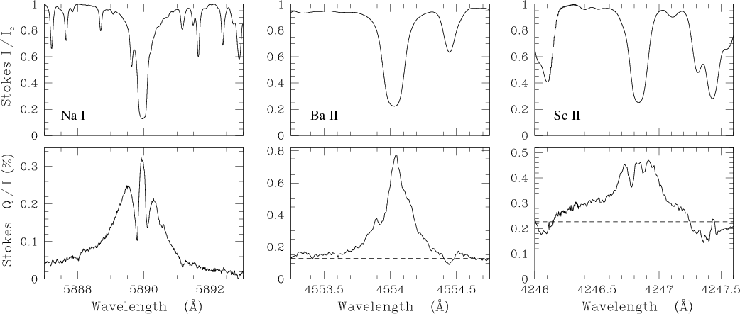
The 2nd solar spectrum is completely different from
the 1st solar spectrum
Belluzzi (2009)

Slide 56
The equations to solve are complex but there are tools for that
Statistical
equilibrium
equations
Emission and
absorption
coefficients

Slide 57
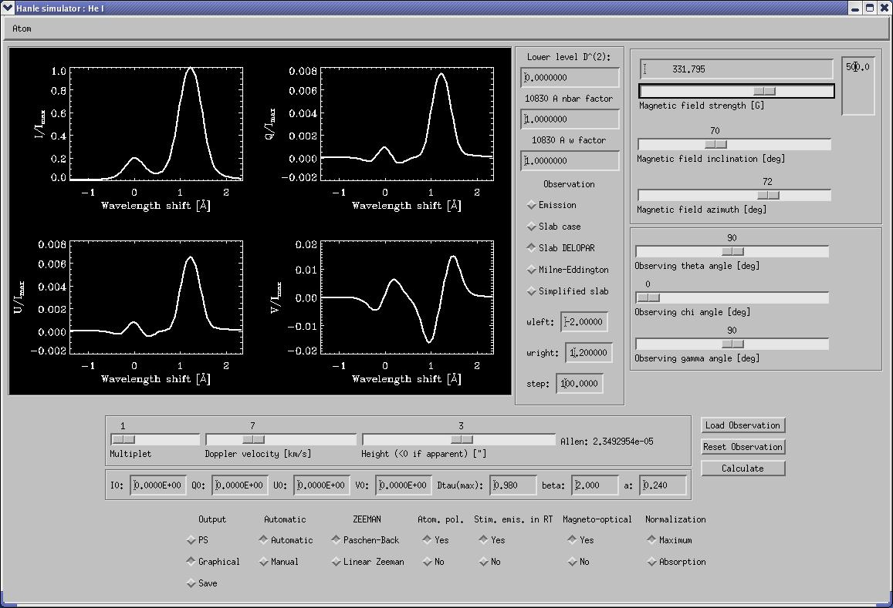
Hanle Zeeman Light (HAZEL)
Asensio Ramos et al. (2008)

Slide 58
http://goo.gl/dj2ob

Slide 59
Inversion procedure (Hazel)
Radiation field
Radiation field anisotropy
B, τ, v_{th}, v_{mac}, a
Solve SEE
equations
Solve RT equation
Emergent profiles
Observed
Stokes profiles
Statistical estimator (χ²)
NO
χ² smaller than
previous?
NO
Convergence?
Propose another
set of parameters
YES
YES
Save parameters
EXIT

Slide 60
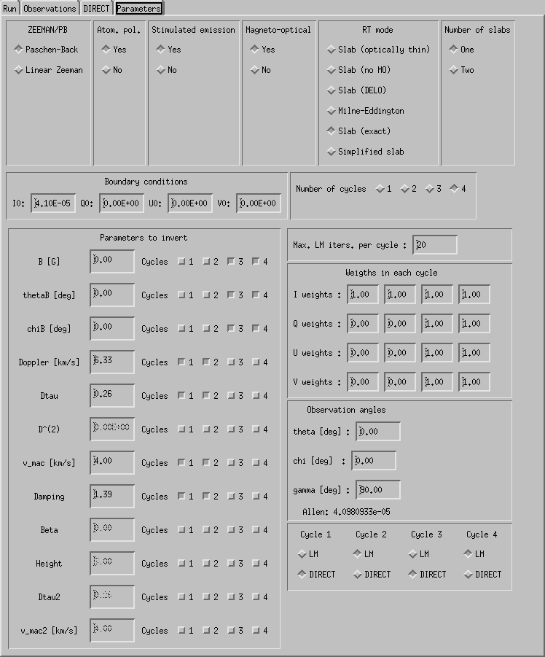
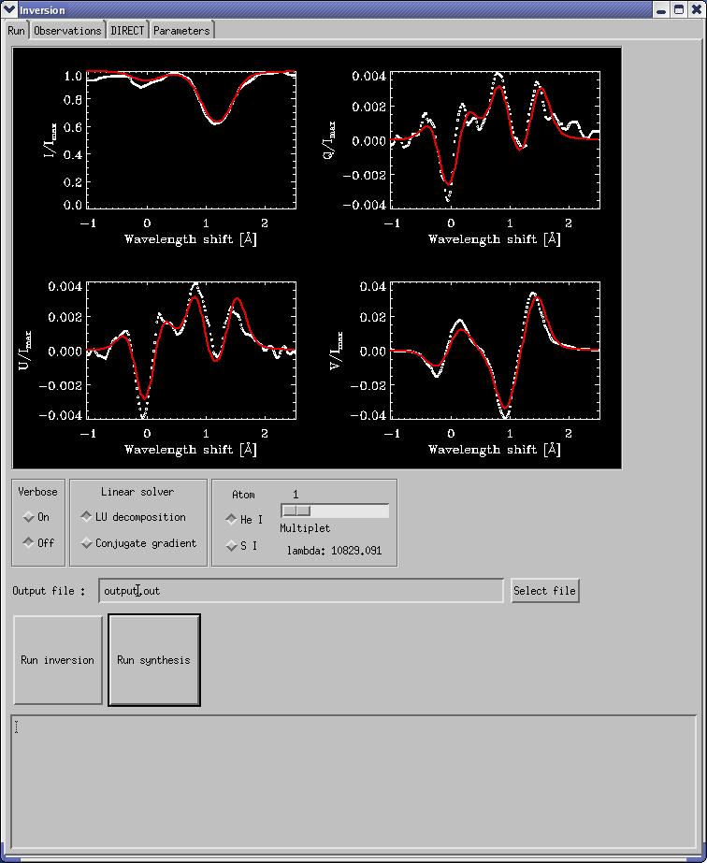
Hazel - Stokes inversion option
http://www.iac.es/proyecto/magnetism/pages/codes/hazel.php

Slide 61
The m.f. in the chromosphere is smoother than in the photosphere
Chromosphere
Photosphere
Asensio Ramos & Trujillo Bueno (2010)

Slide 62
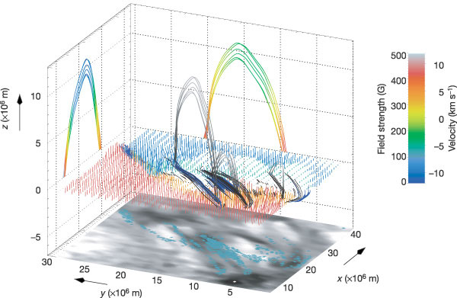
3D topology of magnetic field reconstructed from observations
Solanki et al. (2003)

Slide 63
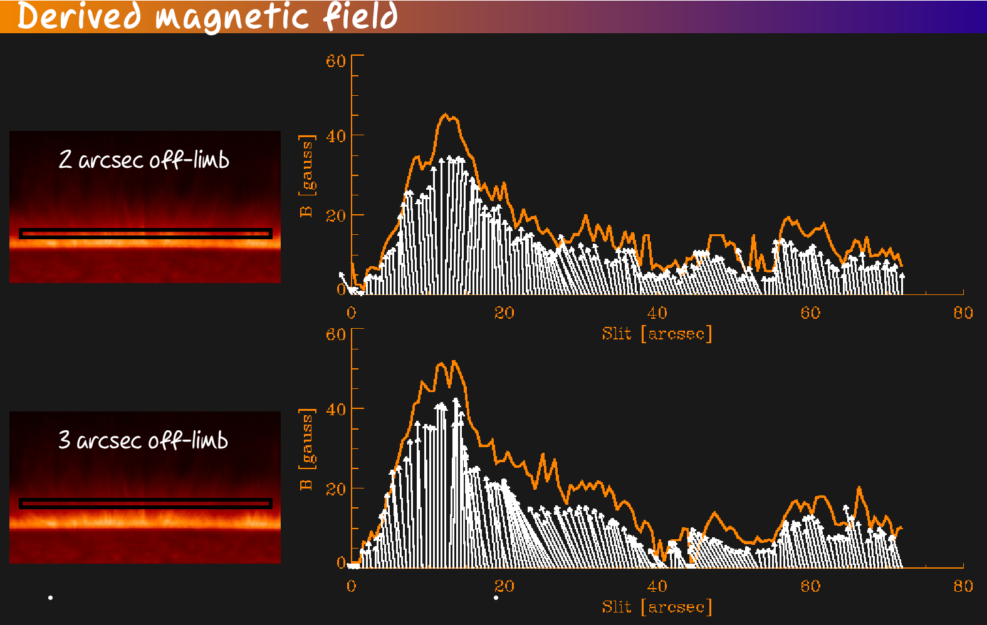
Magnetic field in spicules change with position
Centeno, Trujillo Bueno & Asensio Ramos (2010)

Slide 64
Strange guys are always around
Signatures of
atomic orientation
Martínez González, Asensio Ramos, Manso Sainz, Belluzzi & Beck (2012)

Slide 65
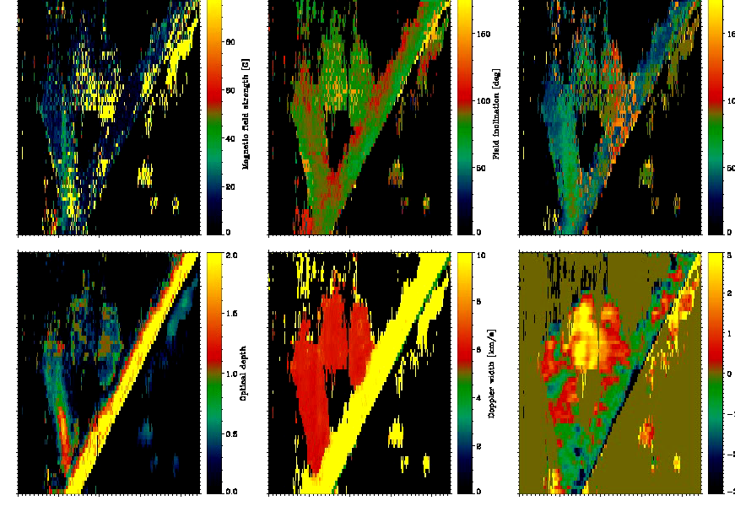
Physical properties in prominences – Four snapshots
TIP observations+PHazel inversions
Martínez González et al. (in prep)

Slide 66
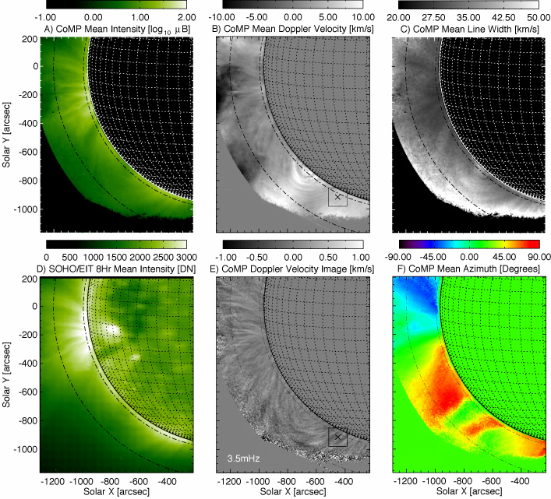
Hanle effect in coronal lines
Tomczyk (2004)

Slide 67
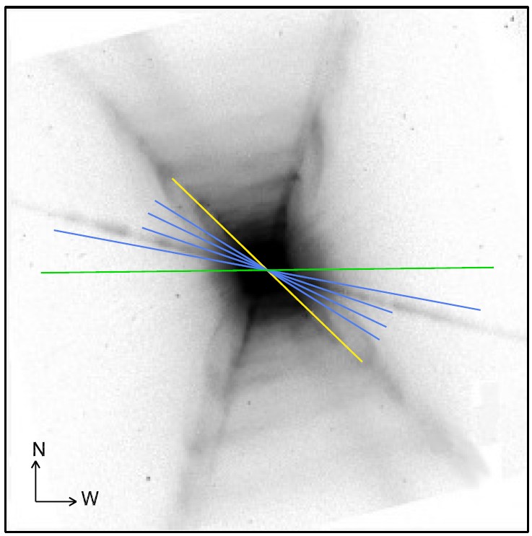

Scattering in central stars of planetary nebula: geometry
Martínez González et al. (in prep)

Slide 68
Available inversion codes
Helix (Lagg et al. 2004) (MPI)
Melanie (Socas-Navarro)
VFISV (Borrero et al. 2007) (Very fast-HMI)
MERLIN (Lites et al. 2007) (Hinode)
MILOS (Orozco Suárez et al. 2007)
Zeeman Milne-Eddington
SIR (Ruiz Cobo & del Toro Iniesta 1992)
Nicole (Socas-Navarro et al. 2000) (MPI)
Zeeman full LTE/NLTE inversion
Hazel (Asensio Ramos et al. 2008) (MPI)
Helix+ (Lagg et al. 2009) (MPI)
Zeeman+scattering

Slide 69
Faraday Rotation

Slide 70

Faraday rotation
A polarized radiation field, interacting with electrons in a magnetic field
produce a rotation of the plane of polarization

Slide 71


Faraday rotation
Circular polarization frequency is modified by the
cyclotron frequency of the plasma
induces a rotation of the polarization

Slide 72



We have the simple generative model
Polarization rotates an angle
Rotation measure →
Since we do not know a priori the original polarization of the light,
we need to measure at two wavelengths and compute
n_{e}~1 cm⁻³, B~1 μG → RM ~ 1 cm⁻² → β ~ 1 rad ~ 57º (λ = 1cm)

Slide 73


The magnetic field can be inferred from the RM

Slide 74
Another instance of a linear fit
If the rotation angle is measured at N wavelengths, the rotation
measure is obtained through a linear fit
http://nbviewer.ipython.org/5611869

Slide 75
Fast inversion schemes

Slide 76
Generation of databases can be an option
Modern telescope are and will generate huge amounts of data
Standard non-linear inversion are too computationally demanding
Fortunately, Stokes profiles of parametric models live only on a low-dimensionality manifold

Slide 77
In high dimensions, unit volumes occupy less and less space
If errors are small → every database is always sparse
Dimension of the unit hypersphere

Slide 78
Emulators
Synthesizing Stokes profiles takes 10⁻⁴ - 1 seconds
3 hours of 2000x2000 pixels at a cadence of 1 min

Slide 79
Look-up table (diagram)
B, T, v
Solve SEE
equations
Solve RT equation
Emergent profiles
Large database

Slide 80
Look-up table (diagram)
B, T, v
Solve SEE
equations
Solve RT equation
Emergent profiles
Compressed
database
Large database
Observed
Stokes profiles
Statistical estimator (χ²)
Best model

Slide 81
Look-up table inversion
Themis code (López Ariste)
ANN (Socas-Navarro)
Zeeman Milne-Eddington
Zeeman+scattering
He I 10830+D3
(Casini, López Ariste & Paletou)

Slide 82
Multiline look-up inversion
Multiline inversions
He I D3+10830 Å
Database of 250000 models
for errors of ~10⁻³
Size of DB for smaller errors?
Are they practical?
Interpolation?
Casini et al. (2009)

Slide 83




Look-up inversions for 10830 Å
B=626 G
θ=80º
Very large fields in
AR filaments
Kuckein et al. (2009)

Slide 84
Solar prominences (look-up inversion)
Casini et al. (2005)

Slide 85
Inversion procedure (Look-up)
PROS
Inversion is fast → computation time depends on the size of the DB
Realistic error bars can be estimated and ambiguities can be located
A good DB opens up the possibility of doing Bayesian computations
CONS
Databases have to be adapted to the problem
Large databases are needed when noise is small for full coverage

Slide 86
Look-up tables – Learning the manifold with SOM
Temperature
Optical depth
Velocity

Slide 87
Look-up tables – Outlook
Practically unavoidable for quick inversion of Stokes profiles → build databases for many observing conditions
Some interpolation techniques needed to avoid enormous DB
Artificial neural network (global)
Polynomial (local)
…
Investigate non-linear manifold learning
Physics can be “discovered” from them
Investigate efficient generation of databases

Slide 88
Conclusions
We have well-developed theories for explaining observations
We have generative models for our observations
We have efficient methods to solve the non-linear inversion problem
The difficulty resides many times on the geometry of the system
The future instruments will provide huge amounts of data that we still don’t know how to handle
Try to use all tools of model fitting available to you

Slide 89
Websites
https://github.com/aasensio/aussois
http://www.iac.es/proyecto/inversion/online/online_tools.php

Slide 90
The forward problem
3p³P
3d³D
3s³S
7065 Å
5876 Å
2p³P
3889 Å
10830 Å
2s³S
The solution to the problem requires to find the self-consistent radiation
field and its polarization and the excitation and polarization state of the
atomic system under consideration

Slide 91

The expected polarization
DISK
CENTER
LIMB
Zeeman effect
Scattering polarization
Hanle effect
Incomplete Paschen-Back
Optically quasi-thin limit
Trujillo Bueno &
Asensio Ramos (2007)

Slide 92


Hazel inversions (filaments)
B = 750 G
θ=97º
Strong fields with
no signature of
atomic polarization
Katsukawa, Asensio Ramos & Trujillo Bueno (in prep.)

Slide 93


Milne-Eddington with Zeeman effect
Standard ME
Chromospheric ME
Other functional forms?
Lites et al. (1988)

Slide 94

Signals in spectral lines

